Slide 1




Web Development :
The Future is Digital

Slide 2

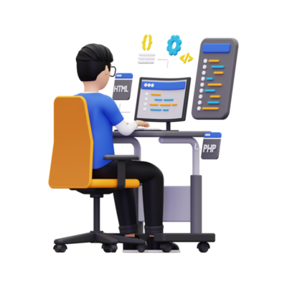

INTRODUCTION
Web development powers the digital world.
From social media to online shopping, it’s everywhere.
Today’s topics:
What is web development ?
Types of web development
Industry demand
How MNCs recruit web developers
Salary & career growth
Skills & tools needed

Slide 3

Building and maintaining websites & web applications.
Includes designing, coding, testing, and deploying.
What is Web Development ?
Examples:
E-commerce (Amazon)
Social media (Instagram)
Streaming (Netflix)
Food delivery (Zomato)

Slide 4
Types of Web Development
Frontend Development:
Creates user interfaces using HTML, CSS, JS.
Frameworks: React, Angular, Vue.js.
Backend Development:
Manages data & functionality.
Technologies: Node.js, Python, PHP, Java.
Databases: MySQL, MongoDB.
Full Stack Development:
Works on both frontend & backend.
Handles full web projects.

Slide 5


Growing Demand for Web Developer
Businesses are rapidly moving online.
Industries hiring: Healthcare, Finance, Education, E-commerce, Entertainment.
Web development market to grow 20% in 5 years.
1.8+ billion websites and counting.
Billions invested in web technologies.

Slide 6
How MNCs Recruit Web Developers
What companies look for:
Technical skills: Languages, Frameworks, Databases.
Problem-solving & algorithms knowledge.
Real-world projects, GitHub profile.
Communication & teamwork skills.
Recruitment Methods:
Hackathons & coding challenges.
Technical interviews.
Campus placements & online portfolios.

Slide 7


01
02
07
Essential Skills & Tools
03
06
04
05
1. Programming
HTML, CSS, JavaScript, Python, PHP, Java.
Entry-Level: ₹3-6 LPA
Mid-Level: ₹6-12 LPA
Senior: ₹12-25 LPA
Lead/Architect: ₹25+ LPA
Salary & Career Growth
2. Frontend
7. Soft Skills
React, Angular, Vue.js.
Problem-solving, creativity, teamwork.
3. Backend
6. Cloud Services
Node.js, Django, Express.
AWS, Azure.
4. Databases
5. Version Control
Alternative Career Paths:
Freelancing (earn in dollars).
Startups & tech businesses.
MySQL, MongoDB, Firebase.
Git & GitHub.
Tip: Build real projects to showcase your skills!

Slide 8
1. Programming
HTML, CSS, JavaScript, Python, PHP, Java.
01
02
2. Frontend
7. Soft Skills
React, Angular, Vue.js.
Problem-solving, creativity, teamwork.
07
Essential Skills & Tools
03
3. Backend
6. Cloud Services
Node.js, Django, Express.
AWS, Azure.
4. Databases
5. Version Control
06
04
MySQL, MongoDB, Firebase.
Git & GitHub.
05
Tip: Build real projects to showcase your skills!

Slide 9


Web development is shaping the future.
Offers high demand, great pay, and endless opportunities.
Start learning, building, and collaborating today!
Let’s code the future together!

Slide 10

Shape the Future :
UI/UX, Game Dev, and AI
Explore careers that celebrate creativity and innovation. Shape how people interact with the world. UI/UX design and game development offer fulfilling paths. Harness AI as your trusted partner.

Slide 11
UI/UX : Design Experiences That Matter
UI (User Interface)
01
Visual storytelling through colors, shapes, and layouts.
UI/UX
UX (User Experience)
02
Seamlessly guiding users with clarity and ease.
Job openings are growing at 8% annually. Entry-level roles start around $70,000.

Slide 12






UI/UX Roadmap:
Four Years to Success
1
Year 1
Master basics: color theory, typography, Figma, Adobe XD.
2
Year 2
User research, usability testing, wireframing, collaboration.
Year 3
Build portfolio: real-world projects, internships, specialization.
3
4
Year 4
Launch career: refine specialization, expand network, lead.

Slide 13
Game Development :
Building Worlds
Design & Art
Create characters, environments, and interfaces.
Build game engines with C# or C++ in Unity/Unreal.
Craft narratives and soundscapes for immersion.
Storytelling & Sound
Coding & Logic
The gaming market is valued at over $200 billion globally.

Slide 14

Game Dev Roadmap : Four Years to Launch
1
Year 1
Learn programming, game engines, develop simple games.
2
Year 2
Explore game design principles, mechanics, level design.
4
Year 4
Specialize, launch project, secure studio position.
3
Year 3
Game jams, collaborative projects, refine skills.

Slide 15




AI: Your Collaborative Partner
AI is not your enemy, it is your friend and assistant. AI tools have increased productivity by up to 40%.
Innovation
Efficiency
Creativity
AI helps you innovate faster.
AI helps you work smarter.
AI elevates your creativity.

Slide 16
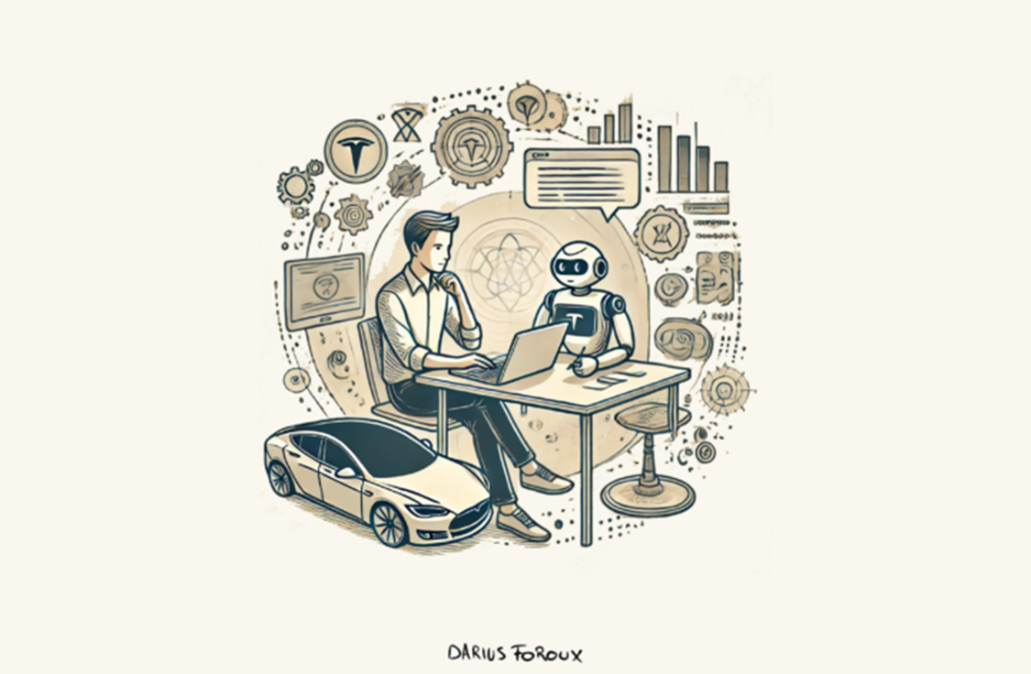
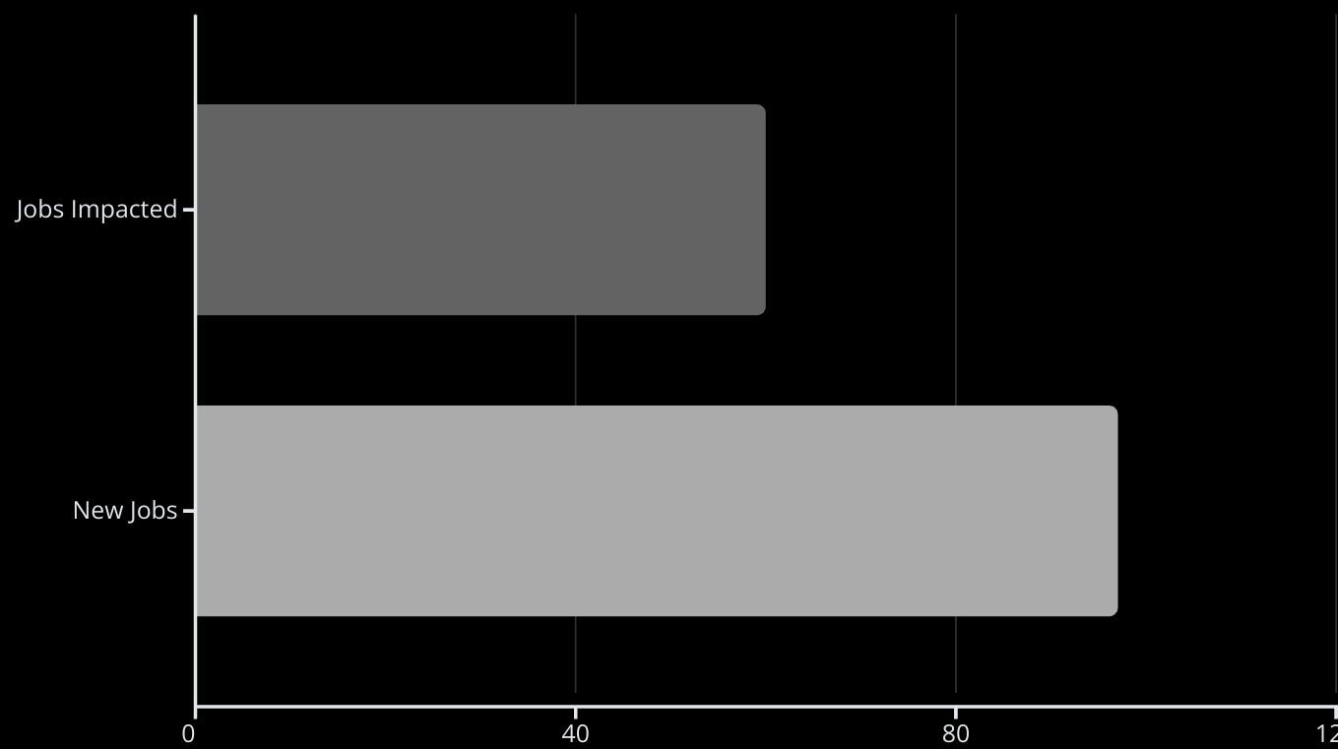
AI Augments, Not Replaces
60% of jobs are impacted by AI. AI augments human creativity. 97 million new jobs could emerge as AI transforms industries.

Slide 17




Join Our Community
01
02
03
04
Expert Mentorship
Collaborative Projects
Exclusive Resources
Networking
Learn from industry leaders.
Build a standout portfolio.
Stay ahead of industry trends.
Accelerate career growth.

Slide 18




Continuous Learning
Stay at the forefront of technologies and design innovations. Combine your creativity with our expertise and AI.
Expertise
Creativity
AI

Slide 19

Embrace the Future
Your creativity and adaptability are your greatest assets. Embrace AI as your ally. Shape a future where creativity and technology walk hand in hand.
THANK YOU

